Slide 1
Airline Review Scraping Summary
Key Findings from Data Analysis

Slide 2
Dataset Overview
- Reviews include ratings for seat comfort, cabin staff, food, and entertainment.
- Data categorized by seat type, traveler type, and route.
- Helps analyze customer satisfaction trends.

Slide 3
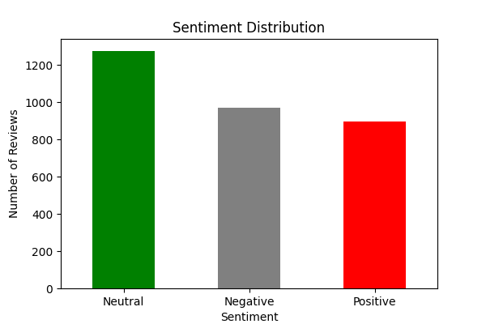
Sentiment Analysis
- Reviews classified as Positive, Neutral, or Negative.
- Text processing techniques used for classification.
- Provides insights into passenger experience.

Slide 4
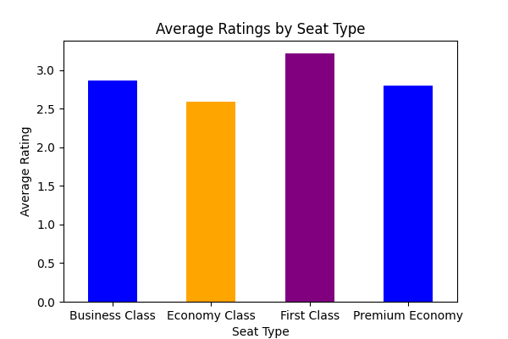
Key Trends
- Premium Economy & Business Class: Higher satisfaction.
- Economy Class: More negative reviews on food & entertainment.
- Long international routes show higher satisfaction.

Slide 5
Scraping Methodology
- Data extracted using BeautifulSoup.
- Ratings, reviews, and traveler details parsed from website tables.
- Ensured structured data collection for analysis.

